Slide 1
Stochastic Simulation for Reaction-Diffusion Systems
Fei Li
Advisor: Prof. Yang Cao
Dec 17, 2014

Slide 2
Outline
Introduction
Stochastic simulation method development for reaction-diffusion systems
Background
Optimal mesh size
Multigrid discretization method
Stochastic modeling & simulation on Caulobacter cell cycle
PopZ localization
Response-regulator network
Chromosome segregation
Conclusion & future work

Slide 3
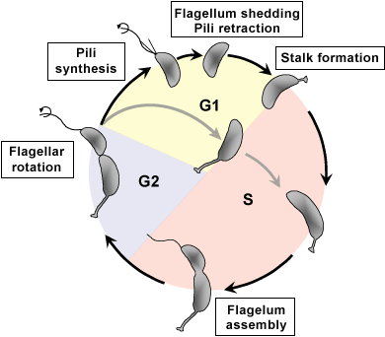
Introduction
Caulobacter crescentus undergoes an asymmetric cell division.
The differences between two daughter cells:
Morphology
Size
Function
Scheme of C. crescentus cell cycle.
http://www.yale.edu/testmcdb/facultystaff/jacobs-wagner.html

Slide 4
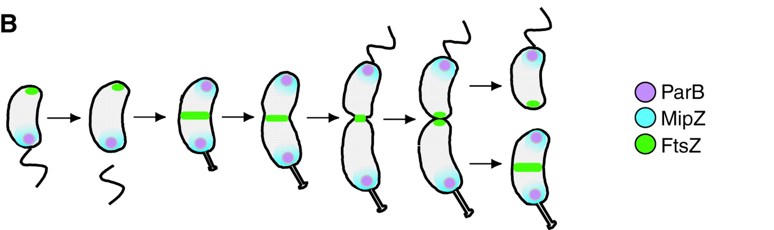
Introduction
Goley E D et al. J Cell Sci 2007;120:3501-3507

Slide 5
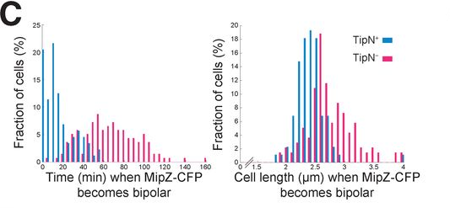
Introduction
Experiment data shows great variations.
Laloux G , and Jacobs-Wagner C J Cell Biol 2013;201:827-841

Slide 6
Outline
Introduction
Stochastic Simulation Method development for reaction-diffusion systems
Background
Optimal mesh size
Multigrid discretization method
Stochastic modeling & simulation on Caulobacter cell cycle
PopZ localization
Response-Regulator Network
Chromosome segregation
Conclusion & future works

Slide 7

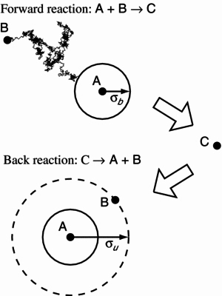
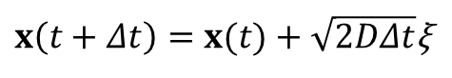
Stochastic Simulation on Reaction-Diffusion Systems
Molecule-Based Framework
Smoluchowski model
Each molecule has an exact position.
Brownian motion
σ-λ bimolecular reaction model
Precise and fundamental
$x\left(t+Δt\right)=x(t)+\sqrt{2DΔt}$ξ
S. S Andrews and D. Bray. Phys. Biol. 1 (2004) 137-151

Slide 8
Stochastic Simulation on Reaction-Diffusion Systems
Compartment-Based Framework
Reaction-Diffusion Master Equation
Space discretization
Random walk
Chemical Master Equation
Suitable for large scale simulations
R. Erban and S. Chapman 2009 Phys. Biol. 6 046001

Slide 9
Stochastic Simulation Algorithm
Well-stirred chemical reaction systems
State vector: X(t)
Propensity function: a_{j}(x) for X(t) = x
State change vector: υ_{j}
Probability that one reaction j fires in time [t, t+τ+dτ)
a₀(x) is the total propensity

Slide 10
Stochastic Simulation Algorithm
SSA answers two questions
When a reaction fires
Which reaction will fire
The system is updated every step according to

Slide 11
Stochastic Simulation Algorithm
There are several implementations of SSA.
Direct method (Gillespie, 1976)
First reaction method (Gillespie, 1976)
Next reaction method (Gibson and Bruck, 2000)
Optimized direct method (Cao, 2004)
Sorting direct method (McCollum, 2006)
Logarithm direct method (Li and Petzold, 2006)
Constant-time SSA (Slepoy, Thompson and Plimpton, 2008)
Several approximation algorithms have been proposed.
τ-leaping (Gillespie, 2001; Gillespie, 2003; Cao, 2004)
Hybrid method (Haseltine, 2003; Salis, 2005; Cao, 2005; )

Slide 12
Discretization Size for RDME
The bimolecular reaction is lost when h is too small.
Reaction propensity correction (Erban and Chapman, 2009)
convergent RDME (Isaacson, 2013)

Slide 13
Outline
Introduction
Stochastic Simulation Method on reaction-diffusion systems
Background
Optimal mesh size
Multigrid discretization method
Stochastic modeling & simulation on Caulobacter cell cycle
PopZ localization
Response-Regulator Network
Chromosome segregation
Conclusion & future work

Slide 14
Optimal Mesh Size
Firings of the reaction/diffusion steps in the PopZ model

Slide 15
Optimal Mesh Size
A simple reaction-diffusion model
A
A
A
Indistinguishable molecules
Difference on the probability density function is small enough
A gives stoichiometric B.
A freely diffuses, while B doesn’t diffuse.

Slide 16
Optimal Mesh Size
Distribution density functions for two molecules
The difference of the probability density functions
Kullback-Leibler divergence
Well stirred assumption:

Slide 17
Optimal Mesh Size
Optimal mesh size
τ_{r} the mean life time with respect to all chemical reactions
Set threshold
The larger diffusion rate usually yields a larger bin size.

Slide 18
Optimal Mesh Size
For the A --→ B model
Numerical results
Figure: Probability density for the molecule of species B over space. The optimal mesh size by our formula yields h^{(c)} = 0.04

Slide 19
Outline
Introduction
Stochastic Simulation Method on reaction-diffusion systems
Background
Optimal mesh size
Multigrid discretization method
Stochastic modeling & simulation on Caulobacter cell cycle
PopZ localization
Response-Regulator Network
Chromosome segregation
Conclusion & future work

Slide 20
Multigrid Discretization Method
h_{A}^{(c)}
A
 |  |  |  |  | A_{i}
B
 |  |  |  |  | B_{i}
h_{B}^{(c)}
Reaction type | Propensity | Reaction rate
A_{i} --> A_{i±1} | 2 D_{A} / (h_{B}^{(c)} )² | D_{A}
null --> A_{i} | ksyn * h_{A}^{(c)} | ksyn
A_{i} --> null | kdeg * A_{i} | kdeg * A_{i}
A_{i} --> B_{j} | k * A_{i} | k * A_{i}
A_{i} + B_{i} --> S |  | k_{a} *A_{i}* B_{i}

Slide 21
Multigrid Discretization Method
h_{A}^{(c)}
A
 | A_{i}
B
 |  |  |  |  | B_{j}
h_{B}^{(c)}
Reaction type | Propensity | Reaction rate
A_{i} --> A_{i±1} | 2 D_{A} / (h_{A}^{(c)} )² | D_{A}
null --> A_{i} | ksyn * h_{A}^{(c)} | ksyn
A_{i} --> null | kdeg * A_{i} | kdeg * A_{i}
A_{i} --> B_{j} | k * A_{i} | k * A_{i}
A_{i} + B_{j} --> S |  | k_{a} *A_{i}* B_{j}

Slide 22
Multigrid Discretization Method
Schnakenberg model
Turing pattern
Used for our PopZ localization model
Significant efficiency improvement

Slide 23
Multigrid Discretization Method

Slide 24
Outline
Introduction
Stochastic Simulation Method on reaction-diffusion systems
Optimal mesh size
Multigrid discretization method
Stochastic modeling & simulation on Caulobacter cell cycle
PopZ localization
Response-Regulator Network
Chromosome segregation
Conclusion & future work

Slide 25
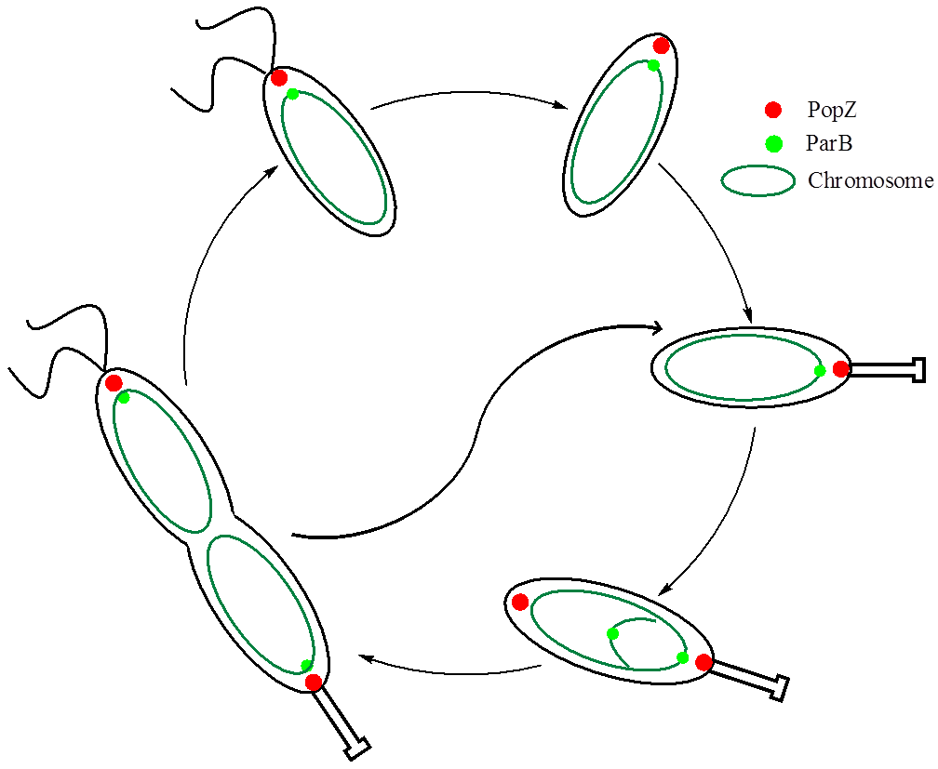
PopZ Localization
PopZ is a landmark protein.
The detailed mechanism behind the PopZ localization is still under investigation.
Chromosome translocation is essential to the formation of new-pole PopZ.
Schnakenberg model.

Slide 26
PopZ Localization

Slide 27
PopZ Localization
mRNA
PopZ
Figure: One popZ gene persistently presents at 20% of cell length to the old pole. The gene replication starts at 50min and the replicated gene translocates until it reaches the position of 20% cell length to the new pole. popZ mNRA follows the gene trace, due to the short life time and slow diffusion. PopZ shows a unipolar-to-bipolar transition starting at around 75min.

Slide 28
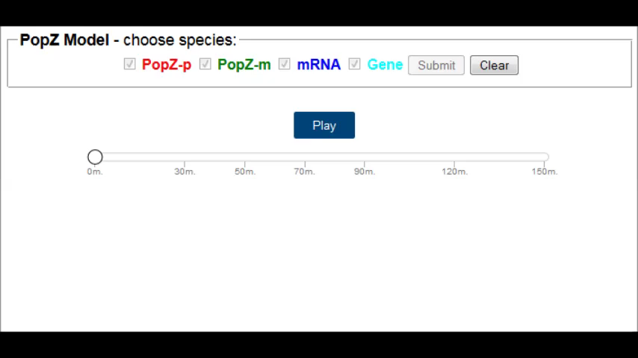
PopZ Localization

Slide 29
PopZ Localization
Figure: Histogram of time (left) and cell length (right) when the gene segregation is completed (green) and PopZ becomes bipolar (red). The stochastic simulation shows a mean value of 63min when gene segregation is completed and a mean value of 97min when PopZ becomes bipolar.

Slide 30
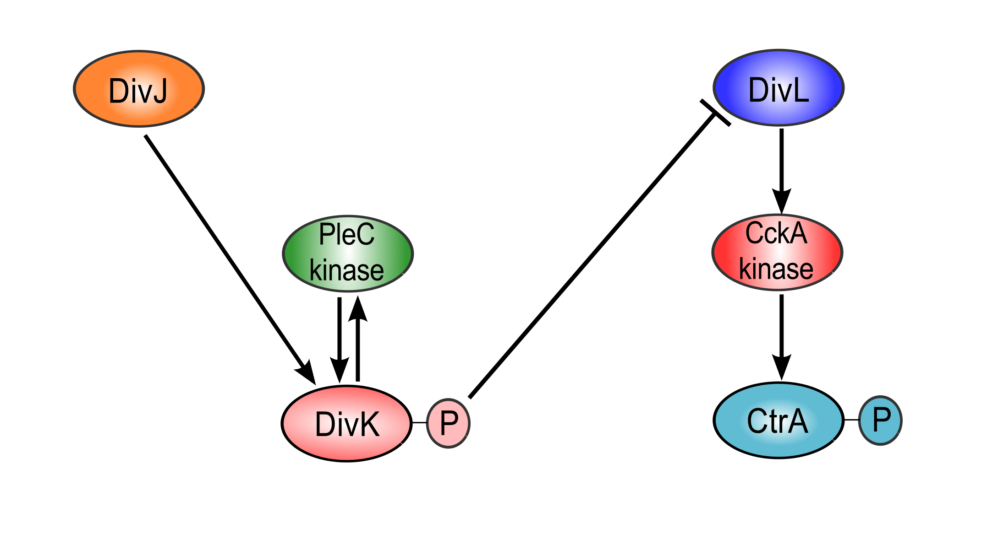
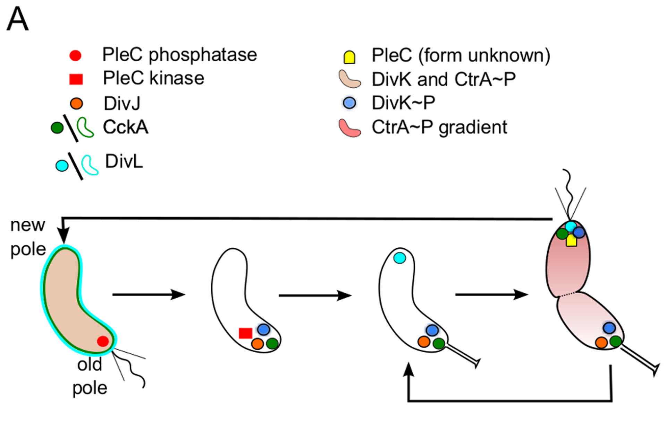
Response-Regulator Network
K. Subramanian, M. R. Paul, and J. J. Tyson. PLoS Comput Biol, 9(9):e1003221, 2013

Slide 31
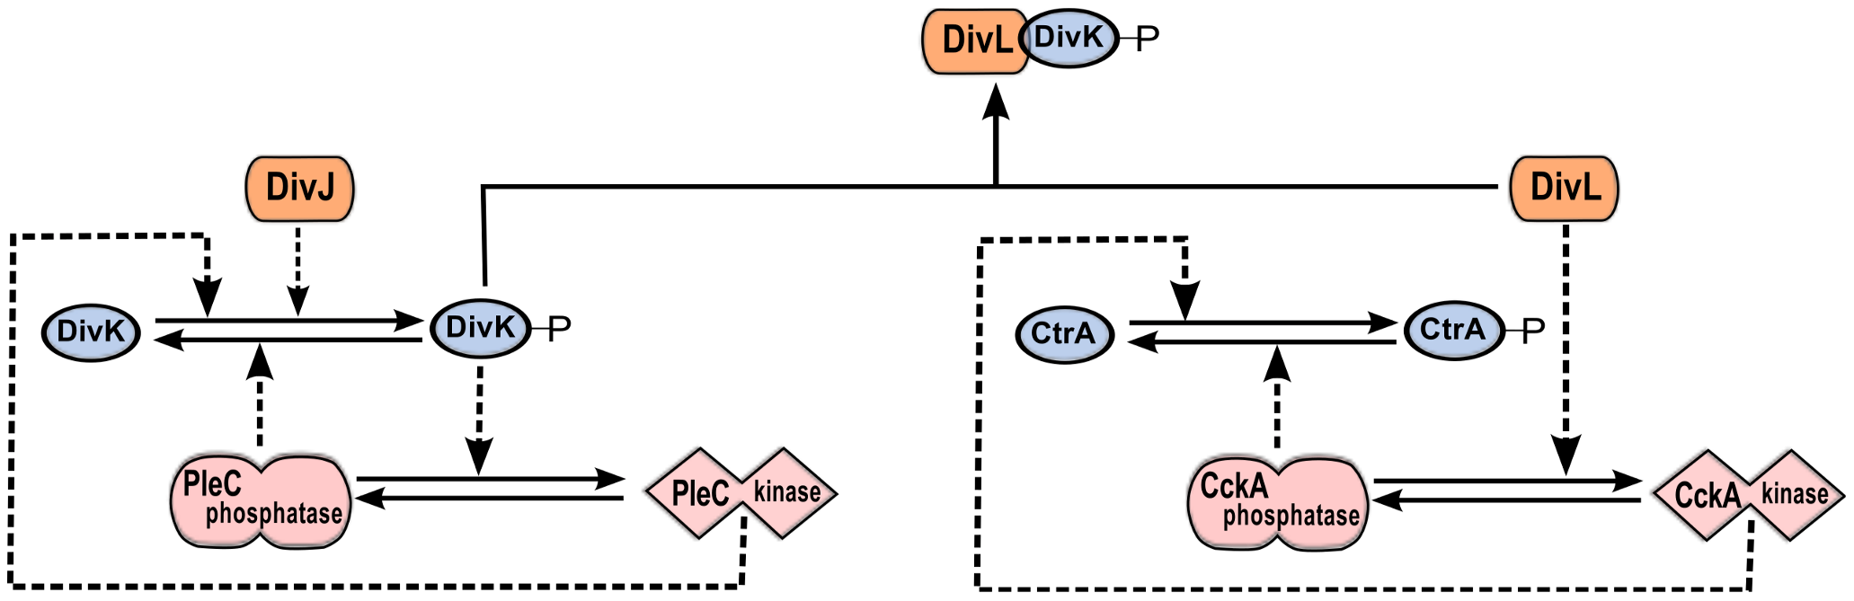
Response-Regulator Network
K. Subramanian, M. R. Paul, and J. J. Tyson. PLoS Comput Biol, 9(9):e1003221, 2013
To demonstrate the stochastic fluctuations, we introduce the gene and mRNA for each protein species.
This model has 45 species, including protein complexes, and 149 reactions.
We model the protein localization as events.

Slide 32
Response-Regulator Network
Figure: The spatial position of divJ gene and the total population of divJ mRNA

Slide 33
Response-Regulator Network
Figure: Spatiotemporal population level of DivJ and DivL. The localization of protein DivJ and DivL is enforced in our model.

Slide 34
Response-Regulator Network
Figure: Spatiotemporal population level of PleC kinase and phosphatase. We enforced the PleC localization, where it serves the different functionalities.

Slide 35
Response-Regulator Network
Figure: Spatiotemporal population level of DivKp. Phosphorylation status of DivK is determined by PleC and DivJ

Slide 36
Response-Regulator Network
Figure: Spatiotemporal population level of CckA kinase and phosphatase. The location of DivL determines the CckA state.

Slide 37
Response-Regulator Network
Figure: Spatiotemporal population level of CtrAp. Phosphorylation states of CtrA is determined by location and state of CckA.

Slide 38
Chromosome Segregation Model
MipZ
FtsZ
TipN
FtsZ
FtsZ
Figure: ParABS system in chromosome segregation

Slide 39
Chromosome Segregation Model
Figure: In the wild type, the chromosome segregation is completed at around 90min. In the ΔtipN mutant, it takes slightly longer for the chromosome segregation. In the D44A mutant, the chromosome segregation cannot be finished during the cell cycle.

Slide 40
Chromosome Segregation Model
Figure: In the wide type, MipZ travels to the new pole and compels FtsZ moving to the middle.

Slide 41
Conclusion & Future Work
Stochastic simulation on reaction-diffusion systems
Optimal mesh size
Multigrid discretization method
Application: the spatiotemporal regulation network in Caulobacter cell cycle.
A hybrid method of compartment-based modeling and molecule-based modeling
A spatial population list, as in RDME
A molecule list, as in Smoluchowski model

Slide 42
Conclusion & Future Work
Timeline for future work
Jan | Feb | Mar | Apr | May | Jun | Jul | Aug | Sep | Oct | Nov | Dec
Submit MGD to journal |  |  | Hybrid molecule-compartment based model |  |  |  |  |  | Wrap up for the hybrid model
Complete stochastic simulation on PleC module, submit paper |  |  |  |  |  | Prepare for research defense |  |  | Prepare for final defense
Work towards the comprehensive Caulobacter full mode

Slide 43
Publication List
F. Li, K. Subramanian, J. J. Tyson and Y. Cao. Stochastic Effect on the Dynamic Localization of DivL and PleC in the Asymmetric Division of Caulobacter crescentus Cell Cycle. In preparation
F. Li and Y. Cao. Multigrid Discretization Method on Multiscale Reaction-Diffusion Systems. To be submitted
K. Subramanian, F. Li , M. R. Paul , Y. Cao and J. J. Tyson. Spatiotemporal model of PopZ localization in Caulobacter crescentus. Submitted to PLOS Computational Biology
Y. Cao, R. Erban, F. Li. Reaction Time for Tri-molecular Reaction. To be submitted.
F. Li and Y. Cao. Multigrid discretization method for PopZ localization model. In Bioinformatics and Biomedicine (BIBM), 2013 IEEE International Conference on. 469-472, 2013, Shanghai, China.
F. Li and Y. Cao. Multiscale Discretization for Reaction Diffusion Systems. in Proceedings of the 2012 International Conference on Bioinformatics & Computational Biology. 305 - 311, 2012, Las Vegas, Nevada, USA.
Z. Liu, Y. Pu, F. Li, C. A. Shaffer, S. Hoops, J. J. Tyson, and Y. Cao. Hybrid modeling and simulation of stochastic effects on progression through the eukaryotic cell cycle. The Journal of Chemical Physics, 136(3):034105, 2012.

Slide 44


Acknowledgement
Prof. Yang Cao
Shuo Wang
Minghan Chen
Prof. John J. Tyson
Kartik Subramanian

Slide 45
Thank You

